Slide 1


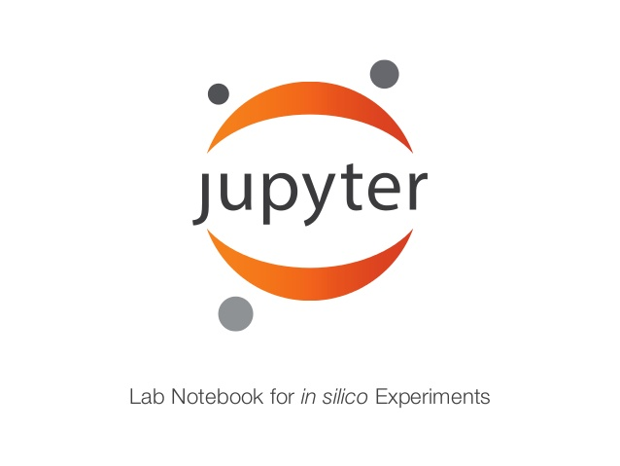



Slide 2
$ jupyter notebook
Notes:
pip3 install jupyter
!pip install packagename

Slide 3
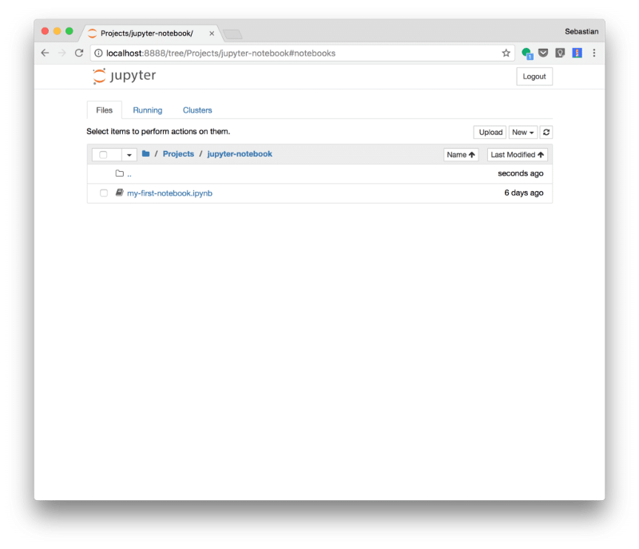
New Notebook

Slide 4
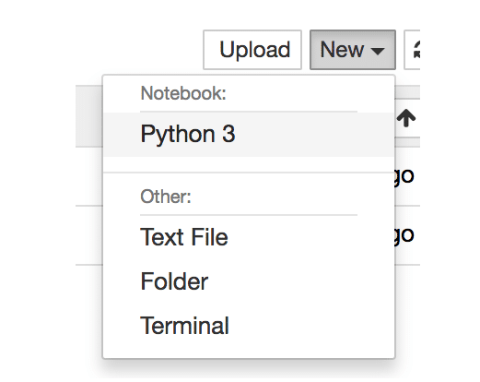
Creating A New Notebook

Slide 5
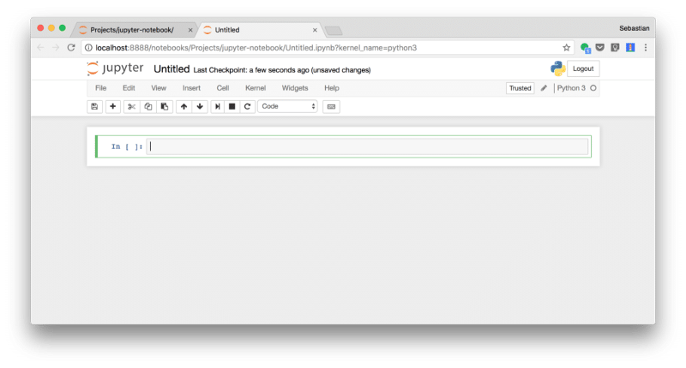

Slide 6
Colab: An easy way to learn and use TensorFlow
https://colab.research.google.com/github/tensorflow/docs/blob/master/site/en/tutorials/_index.ipynb
Notes:
Colaboratory is a hosted Jupyter notebook environment that is free to use and requires no setup.

Slide 7
TensorFlow is already pre-installed
colab.research.google.com

Slide 8
Setup your libraries and data dependencies in code cells
Creating a cell with !pip install or !apt-get works as you’d expect. It also makes it easy for others to reproduce your setup.

Slide 9
Use it with Github
colab.research.google.com/github/
https://github.com/Quantumgame/DeepLearningZeroToAll/blob/master/ipynb/lab-01-basics.ipynb

Slide 10
Hardware acceleration
You can switch your notebook to run with GPU by going to Runtime > Change runtime type, and then selecting GPU. You can also have a Colab notebook use your local machine’s hardware by following these

